Slide 1
Essential Modelling & Bioinformatics to Advance Preclinical Decision Making
Data & Clarity
Tao You & John Prime
Tumour Models, 3 Dec 2019

Slide 2
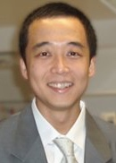




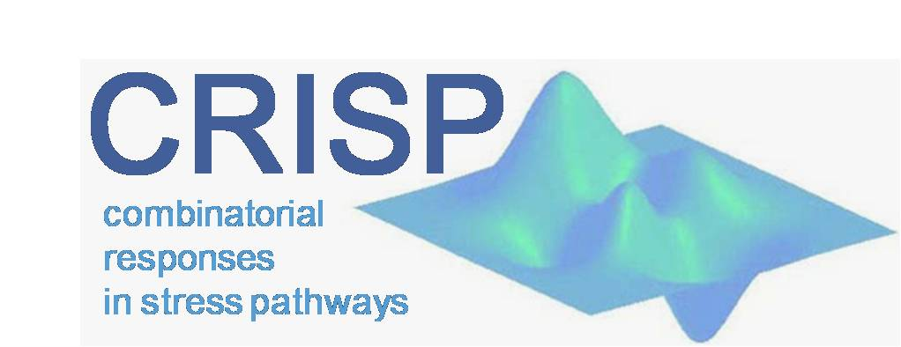



Essential Modelling & Bioinformatics to Advance Preclinical Decision Making
Instructor
Tao You, PhD. PK/PD Modelling & Data Scientist, Beyond Consulting Ltd
Chemical Engineering, BE, 1998-2002
Biological and Chemical Engineering, MSc, 2002-2003
Cancer Bioinformatics, 2003-2005
Systems Biology, PhD, 2005-2009
Systems Biology, Postdoc, 2009-2011
Physiological Modeller & PK/PD Modeller, 2011-2015
PK/PD Modelling Lab Head, 2016-2018
PK/PD Modeller & Data Scientist, Aug 2018 – now
https://www.letsgobeyond.co.uk/testimonials
Singapore–MIT Alliance

Slide 3
Section Title

Slide 4
Subsection Title
Learning objectives

Slide 8
Disclaimer The content of this presentation may be subject to alterations and updates. Therefore, information expressed in this presentation may not reflect the most up-to-date information, unless otherwise notified by an authorised representative independent of this presentation. No contractual relationship is created by this presentation by any person unless specifically indicated by agreement in writing.
GNU General Public Licence v3.0
https://github.com/TheOpenProject/TOM/blob/master/LICENSE
Permissions of this strong copyleft licence are conditioned on making available complete source code of licensed works and modifications, which include larger works using a licensed work, under the same licence. Copyright and licence notices must be preserved. Contributors provide an express grant of patent rights.
The Open Project is hosted on GitHub at https://github.com/theopenproject
Contact Information: Please contact Tao You: Email: tao.you@letsgobeyond.co.uk or visit www.letsgobeyond.co.uk.
Created in Microsoft® PowerPoint for Mac. Version 16.30 (19101301)
Permissions | Limitations | Conditions
√ Commercial use √ Modifications √ Distribution √ Patent use √ Private use | × Liability × Warranty | License and copyright notice State changes Disclose source Same license

